Slide 1
基於 OpenFeature 的
Feature Toggle 系統實踐
TSMC/ 許郁彬 Yubin Hsu
Notes:
DevOpsDays 2024
2024/07/10

Slide 2
Agenda
Feature Toggle
OpenFeature
Lab

Slide 3

Whoami
許郁彬 Yubin Hsu
TSMC IT/ TSID

Slide 4
Feature Toggle
又叫Feature Flag(開關)
Notes:
just an “if statement”

Slide 5
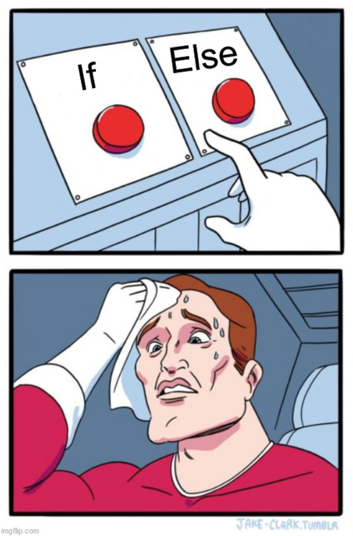
Feature Toggle
Feature Flag
const myFeatureFlag = true
if ( myFeatureFlag ) {
// new feature
} else {
// old feature
}
Notes:
just an “if statement”

Slide 6
Change the Flag
const myFeatureFlag = false =>這是source code
// …
Flag Change
build
New Release
New Deploy
close old
service
Notes:
修改 flag 的程式碼，重新 build 新的版本，然後把舊的 app 關掉，部署新的 app

Slide 7
CI/CD Flow
image
Flag Change
CI Pipeline
New Artifact
CD Pipeline
New Deploy
Notes:
就算利用 CI/CD 來把這些麻煩事自動化，還是很慢

Slide 8
Change the flag at runtime
not build time
not deploy time
不應該用程式碼去更改flag,部屬出去,希望程式運行中,決策者去開關
Notes:
不要把 feature 的開關在 build time 實現,
deploy time?

Slide 9
Flag from Environment Variable
(12-factor: store config in the environment)
const flagA = process.env.ENABLE_FEATURE_A || ‘true’ =>定義在環境變數
const enableFeatureA = Boolean(flagA)
if ( enableFeatureA ) {
// new feature
} else {
// old feature
}
Notes:
just an “if statement”

Slide 10
Deploy the Application !== Release Feature
k8s Deployment
Deployment
env:
name: ENABLE_FEATURE_A
value: ‘true’
name: ENABLE_FEATURE_B
value: ‘true’
Release Feature
這兩件事分開來看解偶
Notes:
部署應用程式 !== 發佈新功能
decouple

Slide 11
Core Concept
Feature Flag
Configuration 就會發生在run time
Targeting 把某個資訊分類 對自己的公司開一個實驗的功能,其他不要
Rollout Strategies

Slide 12
Types of feature flags
Release的目的 擔心什麼功能不好,做個開關
Experiment 實驗性質,想了一個演算法,不用部屬兩個版本(在部屬十),使用 feature flags
Operational ex:可實現runtime的時候改log level
Kill Switch 系統設計在某種情況降級,ex:購物網站推薦系統某個原因功能不好,可藉由Kill Switch 先關掉
Permission
https://www.getunleash.io/blog/guide-to-feature-flags
Notes:
Release
Enable trunk-based development for teams practicing Continuous Delivery.
Experiment
Perform multivariate or A/B testing.
Operational
Control operational aspects of the system’s behavior.
Kill switch
Gracefully degrade system functionality. You can read about kill switch best practices on our blog.
Permission
Change the features or product experience that certain users receive.

Slide 13
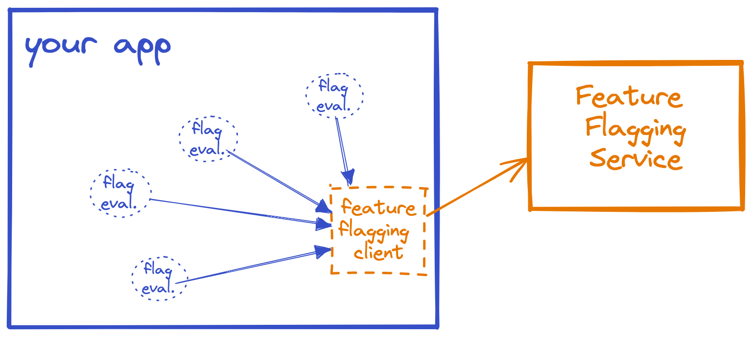
Feature Flagging Service
Feature的時間點放外部
拿到flag由client
https://openfeature.dev/docs/reference/intro

Slide 14
OpenFeature

Slide 15

OpenFeature 有做了標準化
Standardizing Feature Flagging for Everyone
CNCF Incubating (2023-11-21)
https://openfeature.dev

Slide 16
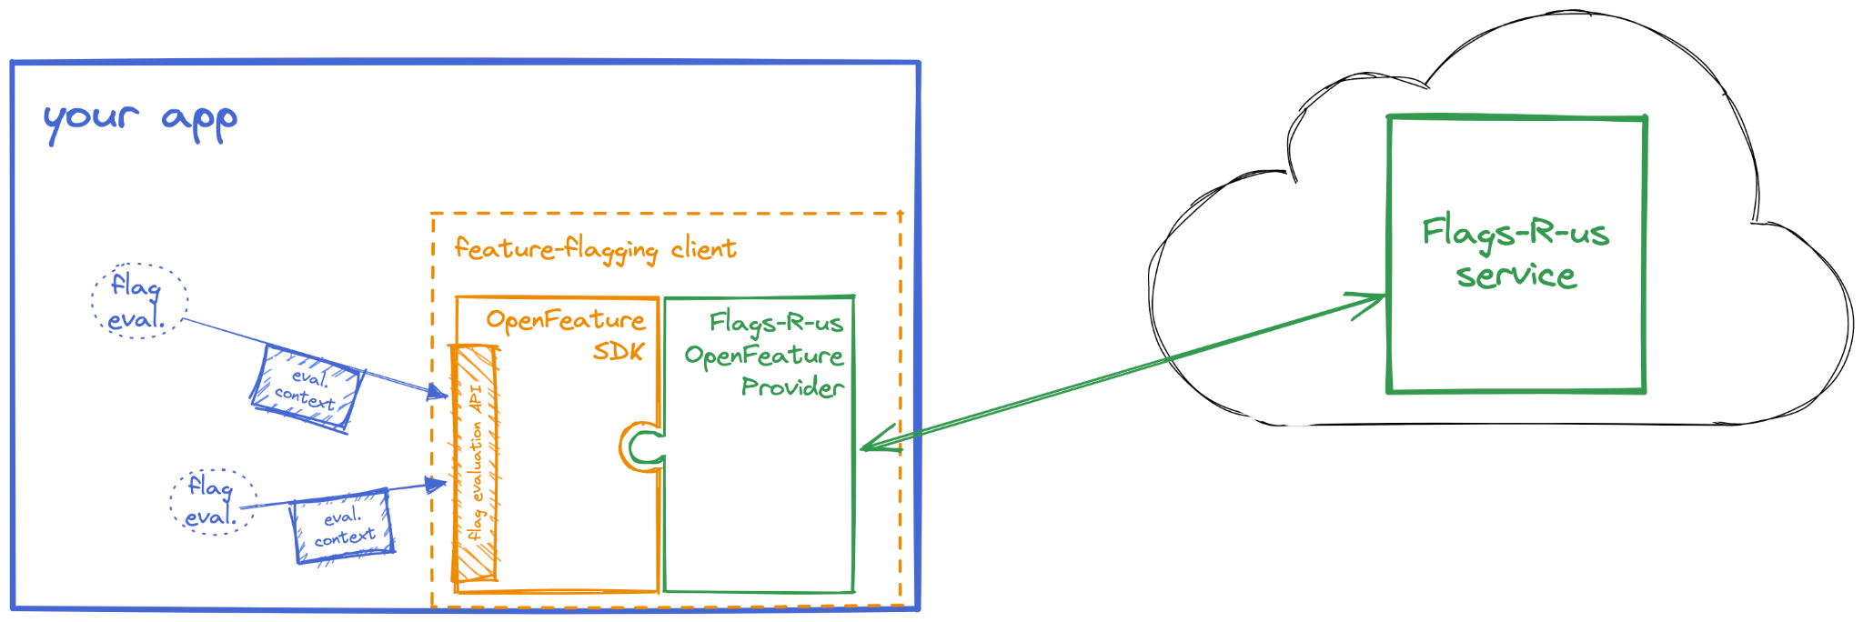
OpenFeature Arch.
跟service的中介有對應的procider

Slide 17
OpenFeature Concepts
Evaluation API
Providers
Evaluation Context
Hooks
Events
https://openfeature.dev/docs/category/concepts

Slide 18
Evaluation API 想拿到flag的api
The Evaluation API is the primary component of OpenFeature that application authors interact with.
Application
Flag
OpenFeature Client
Flag Service
Evaluation API
Provider
Flag

Slide 19
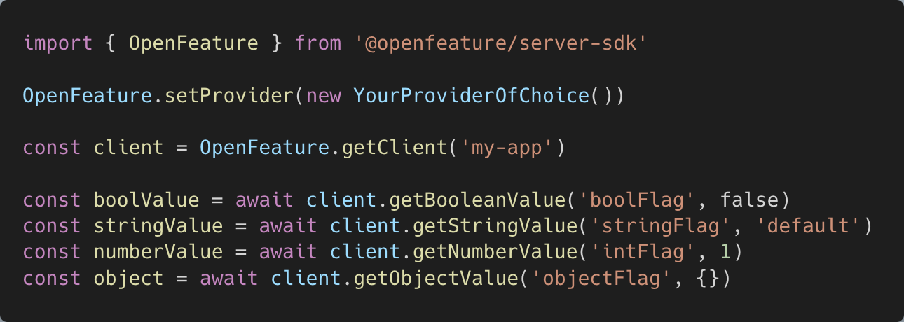
Evaluation API
defalle cliert壞掉的話
抽換provider
Notes:
import { OpenFeature } from '@openfeature/server-sdk'
OpenFeature.setProvider(new YourProviderOfChoice())
const client = OpenFeature.getClient('my-app')
const boolValue = await client.getBooleanValue('boolFlag', false)
const stringValue = await client.getStringValue('stringFlag', 'default')
const numberValue = await client.getNumberValue('intFlag', 1)
const object = await client.getObjectValue('objectFlag', {})

Slide 20
Providers
Providers are responsible for performing flag evaluations.
Application
Flag
OpenFeature Client
Flag Service
Evaluation API
Provider
Flag

Slide 21
Providers
ConfigCat
FeatBit
Flagsmith
LaunchDarkly
Unleash
flagd =>openfeature 出的
environment variable
…
// implement your own provider
https://openfeature.dev/ecosystem

Slide 22
Evaluation Context
The evaluation context is a container for arbitrary contextual data that can be used as a basis for dynamic evaluation.
Evaluation
Context
Flag
Evaluation API
flag藉由flagservice 決策包裝成

Slide 23
Evaluation Context
get flag value
{
location: ‘Asia’
}
Application
Flags Service
flag value: ‘on’

Slide 24
Evaluation Context
get flag value
{
location: ‘Europe’
}
Application
Flags Service
flag value: ‘off’

Slide 25
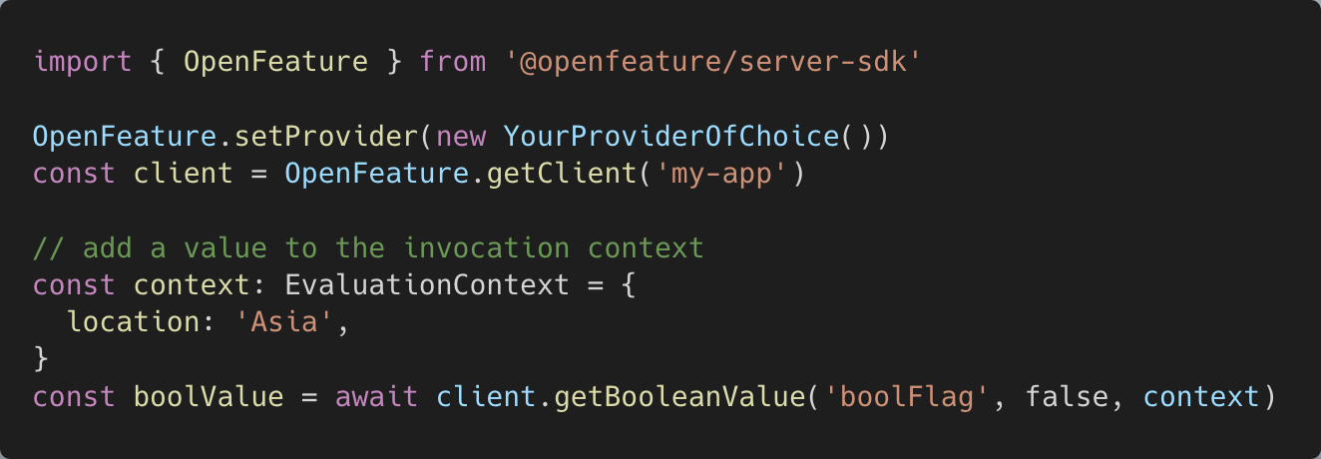
Evaluation Context
Notes:
import { OpenFeature } from '@openfeature/server-sdk'
OpenFeature.setProvider(new YourProviderOfChoice())
const client = OpenFeature.getClient('my-app')
// add a value to the invocation context
const context: EvaluationContext = {
location: 'Asia',
}
const boolValue = await client.getBooleanValue('boolFlag', false, context)

Slide 26
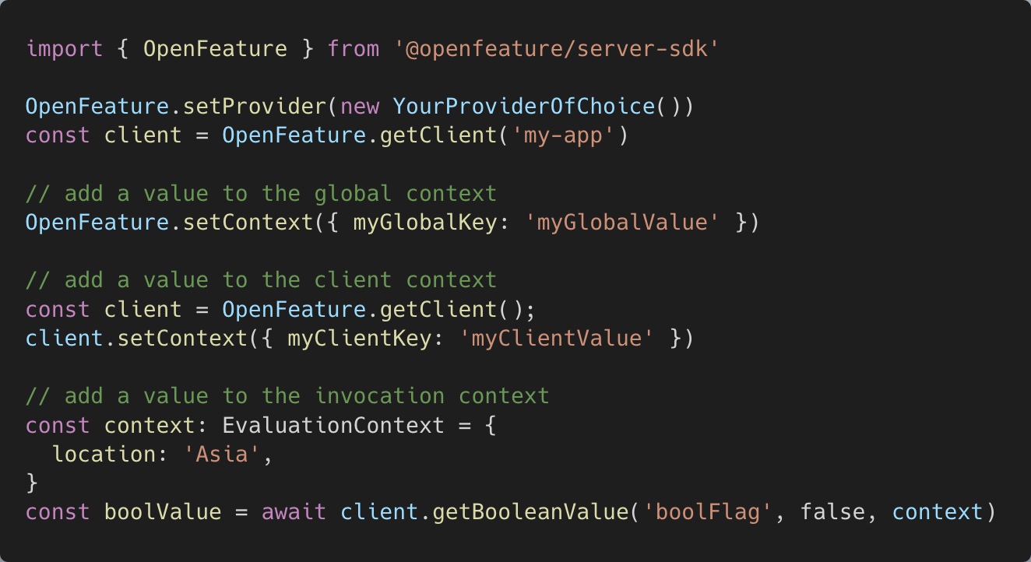
Evaluation Context
Notes:
import { OpenFeature } from '@openfeature/server-sdk'
OpenFeature.setProvider(new YourProviderOfChoice())
const client = OpenFeature.getClient('my-app')
// add a value to the global context
OpenFeature.setContext({ myGlobalKey: 'myGlobalValue' })
// add a value to the client context
const client = OpenFeature.getClient();
client.setContext({ myClientKey: 'myClientValue' })
// add a value to the invocation context
const context: EvaluationContext = {
location: 'Asia',
}
const boolValue = await client.getBooleanValue('boolFlag', false, context)

Slide 27
Hooks openfeature提供flag的評估時發生錯誤時處理
Hooks are a mechanism that allow for the addition of arbitrary behavior at well-defined points of the flag evaluation life-cycle.
https://openfeature.dev/docs/reference/concepts/hooks

Slide 28
Evaluation Life Cycle
hooks
Before
After
Error
Finally
Before
before時機資料轉換(有個資的話 避免送到service時事外部怕沒防資安)
Flag Evaluation
After
Error
Finally

Slide 29
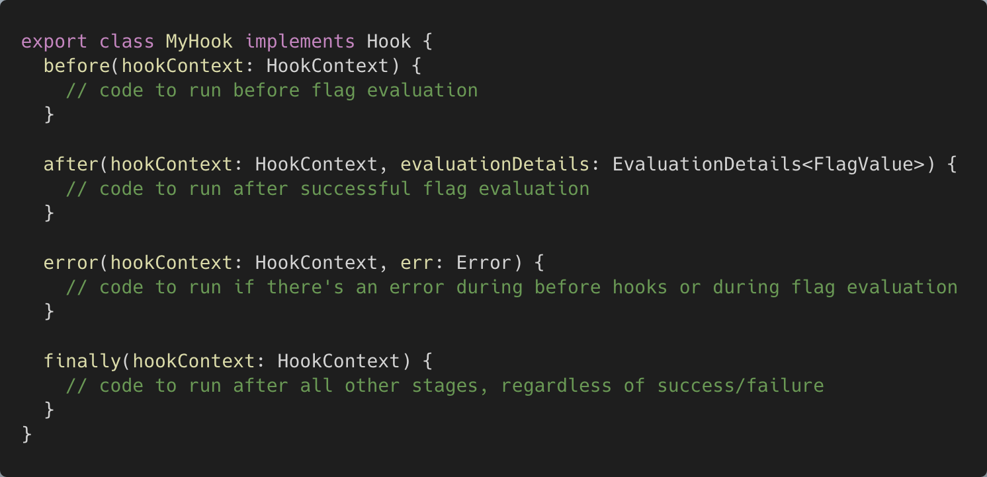
Implement Hooks
Notes:
export class MyHook implements Hook {
before(hookContext: HookContext) {
// code to run before flag evaluation
}
after(hookContext: HookContext, evaluationDetails: EvaluationDetails<FlagValue>) {
// code to run after successful flag evaluation
}
error(hookContext: HookContext, err: Error) {
// code to run if there's an error during before hooks or during flag evaluation
}
finally(hookContext: HookContext) {
// code to run after all other stages, regardless of success/failure
}
}

Slide 30
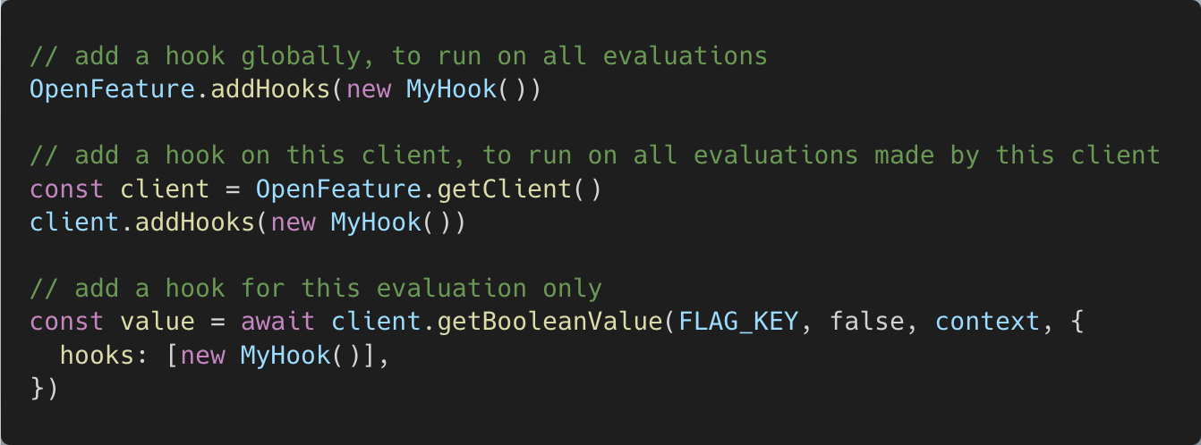
Adding Hooks to Flag Evaluation
Notes:
// add a hook globally, to run on all evaluations
OpenFeature.addHooks(new MyHook())
// add a hook on this client, to run on all evaluations made by this client
const client = OpenFeature.getClient()
client.addHooks(new MyHook())
// add a hook for this evaluation only
const value = await client.getBooleanValue(FLAG_KEY, false, context, {
hooks: [new MyHook()],
})
—
Ordering
Hooks are evaluated in the following order:
before: API, Client, Invocation
after: Invocation, Client, API
error (if applicable): Invocation, Client, API
finally: Invocation, Client, API
Hooks added at the same level (API, client, or invocation) are evaluated in the order they are added.

Slide 31
Events
Events enable the ability to react to state changes in the provider or underlying flag management system.

Slide 32
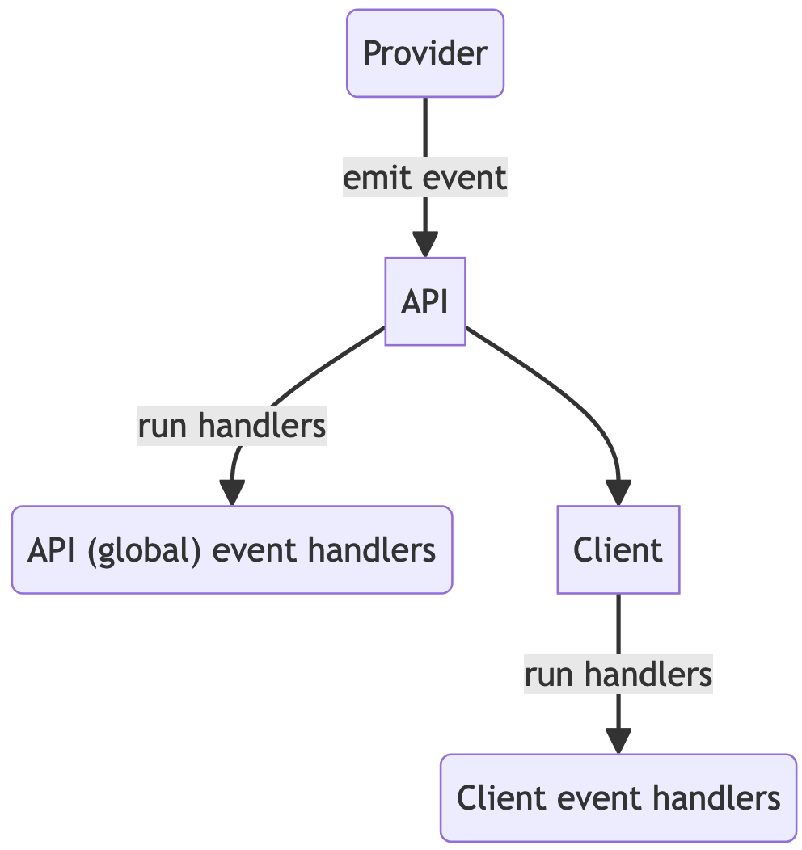
Event Types
PROVIDER_READY
PROVIDER_ERROR
PROVIDER_CONFIGURATION_CHANGED
PROVIDER_STALE
PROVIDER_RECONCILING
PROVIDER_CONTEXT_CHANGED
https://openfeature.dev/docs/reference/concepts/events

Slide 33

Flagd 他是外部的一個flag的service
A feature flag daemon with a Unix philosophy.
https://github.com/open-feature/flagd

Slide 34
Lab
https://github.com/yubinTW/openfeature-lab
Requirements
node v20+
docker (with docker compose)
kubectl
kind
helm

Slide 35
Lab01
Client
Application
Flagd
watch
flagged service會監看flag
Flag Definition
File
https://github.com/yubinTW/openfeature-lab/tree/main/lab01

Slide 36
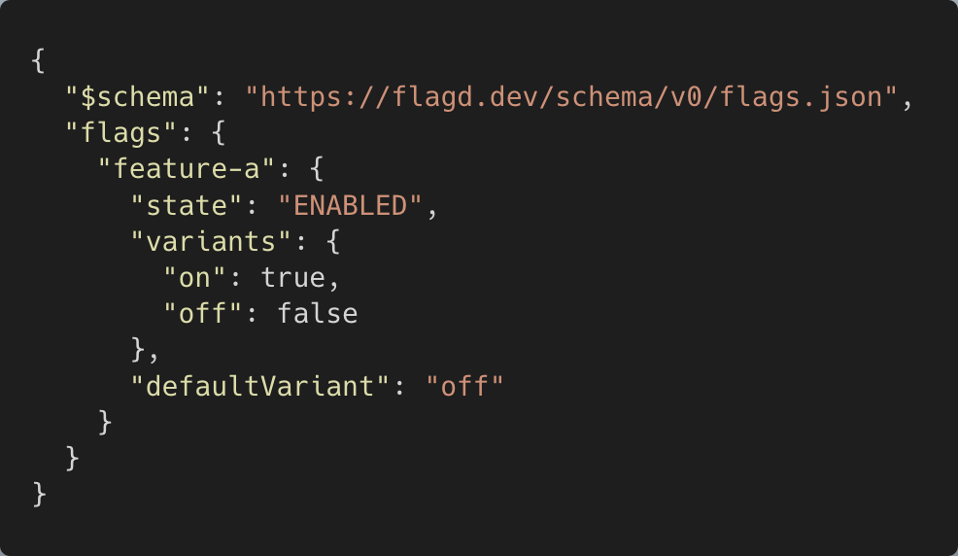
Flag Definitions
https://flagd.dev/reference/flag-definitions/

Slide 37
Lab02
Targeting and Monitoring

Slide 38
Lab02
evaluation with context
Client
Application
Flagd
request from my company
request from others
/metrics
watch
Prometheus
Flag Definition
File
PromQL
Grafana
targeting
規則
https://github.com/yubinTW/openfeature-lab/tree/main/lab02

Slide 39
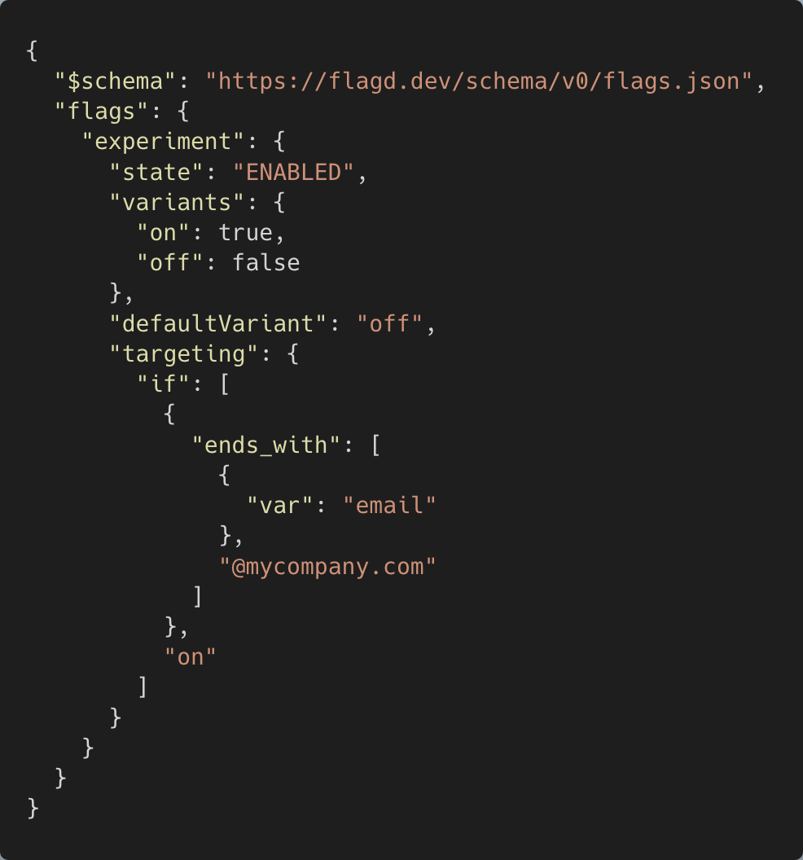
Targeting
ref: Targeting Rules
Notes:
{
"$schema": "https://flagd.dev/schema/v0/flags.json",
"flags": {
"experiment": {
"state": "ENABLED",
"variants": {
"on": true,
"off": false
},
"defaultVariant": "off",
"targeting": {
"if": [
{
"ends_with": [
{
"var": "email"
},
"@mycompany.com"
]
},
"on"
]
}
}
}
}

Slide 40
Flagd Syncs
Syncs are the abstraction that enables different sources for feature flag definitions.
Flagd
watchs
polls
sync.proto
watchs
file
http
grpc
kubernetes

Slide 41
Lab03
OpenFeature Operator(k8s的 flagd會存在soka,不用起flagd) 跟lab01 02 都是file,lab03寫在ymal
https://github.com/open-feature/open-feature-operator/
https://github.com/yubinTW/openfeature-lab/tree/main/lab03

Slide 42
GitOps Workflow with OpenFeature Operator
Flag Change
GitOps Engine
Release
Feature
update yaml,
commit, push,
Release Pipeline
diff/sync,
update FeatureFlag CR
watch FeatueFlag CR

Slide 43
Best Practices
When in Doubt, Put It Behind a Feature Flag
Differentiate Short-Term and Long-Term Feature Flags
Don't Nest Feature Flags In Your Code
Minimize the Life-Time of a Feature Flag
https://bennadel.com/3766

Slide 44

Technical Debt
Flags are Technical Debt.

Slide 45
Best Practices
Create Separate Tickets For the Three Phases of Feature Flags
A ticket for writing and deploying the code.
A ticket for rolling-out and evaluating the code.
A ticket for removing the feature flag.
Roll Feature Flags Out as Quickly as Possible
Always Monitor Logs and Graphs During Feature Flag Activation
…
https://bennadel.com/3766

Slide 46

OpenFeature

Slide 47
Thx.

Slide 48
References
https://www.getunleash.io/blog/guide-to-feature-flags
https://www.bennadel.com/blog/3766-my-personal-best-practices-for-using-launchdarkly-feature-flags.htm
https://openfeature.dev/docs/category/concepts
https://github.com/open-feature/open-feature-operator
https://openfeature.dev/docs/tutorials/open-feature-operator/quick-start

